Slide 1
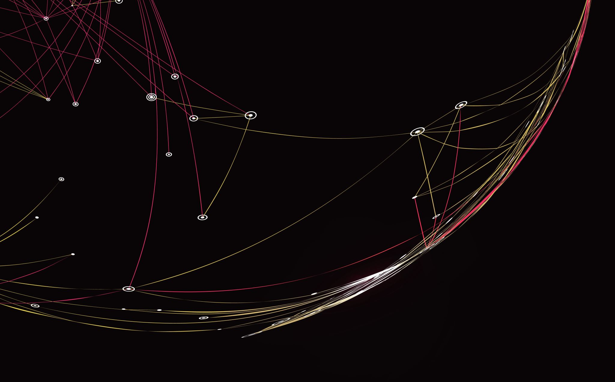
Generalized linear mixed models(GLMMs)
Narges Sohrabi
July 2015

Slide 2
Learning objectives
Understand the limitations of standard linear models (e.g. linear regression, ANOVA).
Understand the benefits of linear mixed-effects modelling.
Understand the benefits of generalized linear modelling.

Slide 3
Outline
Linear model (LM)
Linear Mixed Models(LMMs)
Generalized linear models(GLMs)
Generalized linear mixed models(GLMMs)

Slide 4

Linear model (LM)

Slide 5
Linear model(linear regression)
Linear regression analysis is used to predict the value of a variable based on the value of another variable.
The variable you want to predict is called the dependent variable.
The variable you are using to predict the other variable's value is called the independent variable.

Slide 6
Assumption
The variables should be measured at a continuous level. Examples of continuous variables are time, sales, weight and test scores.
Use a scatterplot to find out quickly if there is a linear relationship between those two variables.
The observations should be independent of each other (that is, there should be no dependency).
Your data should have no significant outliers.
Check for homoscedasticity — a statistical concept in which the variances along the best-fit linear-regression line remain similar all through that line.
The residuals (errors) of the best-fit regression line follow normal distribution.

Slide 7
What to do if your residual plot indicates nonlinearity?
There’s several options
You might miss an important fixed effect that interacts with whatever fixed effects you already have in your model. Potentially the pattern in the residual plot goes away if this fixed effect is added.
Another (commonly chosen) option is to perform a nonlinear transformation of your response, e.g., by taking the log-transform.
You can also perform a nonlinear transformation of your fixed effects. So, if age were somehow related to pitch in a U-shaped way (perhaps, if very young people had high pitch and very old people had high pitch, too, with intermediate ages having a “dip” in pitch), then you could add age and age2 (age-squared) as predictors.
Finally, if you’re seeing stripes in your residual plot, then you’re most likely dealing with some kind of categorical data – and you would need to turn to a somewhat different class of models, such as logistic models.

Slide 8
Collinearity
If there’s collinearity, the interpretation of the model becomes unstable:
Depending on which one of correlated predictors is in the model, the fixed effects become significant or cease to be significant.
the significance of these correlated or collinear fixed effects is not easily interpretable, because they might steal each other’s “explanatory power” (that’s a very coarse way of saying what’s actually going on, but you get the idea).
Intuitively, this makes a lot of sense: If multiple predictors are very similar to each other, then it becomes very difficult to decide what, in fact, is playing a big role

Slide 9
How to get rid of collinearity?
Well first of all, you might pre-empt the problem in the design stage of your study and focus on a few fixed effects that you know are not correlated with each other. If you didn’t do this and you have several multiple measures to choose from at the analysis stage of your study (e.g., three different ways of measuring “talking speed”), think about which one is the most meaningful and drop the others (be careful here: don’t base this dropping decision on the “significance”). Finally, you might want to consider dimensionreduction techniques such as Principal Component Analysis. These can transform several correlated variables into a smaller set of variables which you can then use as new fixed effects.

Slide 10
Linear Mixed Models(LMMs)

Slide 11
Learning objectives
Understand the limitations of standard linear models (e.g. linear regression, ANOVA).
Understand the benefits of mixed-effects modelling.
Understand the differences between fixed and random effects.
Apply random intercept and random intercept and slope models to nested experimental data.

Slide 12
outline
Load and familiarize ourselves with the RIKZ data that will be used
Perform standard linear regression on a subset of the RIKZ data and check assumptions of model
Explore in greater detail violation of an important assumption of standard linear models; namely, the independence of observations.
Explore ways to overcome this violation without the use of mixed-effects models. What are the drawbacks of these approaches?
Apply both random intercept, random intercept and slope models and simple random-effects only models to RIKZ data. What are the differences between these models? Interpret model output.
Using mixed-effects models for more deeply nested data. Difference between nested and crossed random effects
Discussion of fixed vs random effects, ML vs. REML, other types of mixed-effects models (e.g. GAM models, alternative variance structures, etc.)

Slide 13
Quick linear model recap and extension
Surly you know how to apply linear models to data (e.g. linear regression, ANOVA, etc.) to understand the relationship between predictor ( i.e. independent) and response (i.e. dependent) variables. While such models are incredibly powerful, they are underlain by numerous assumptions that should be met prior to placing any confidence in their results. As a reminder, these assumptions are:
Normality at each X value (or of the residuals)
Homogeneity of variances at each X
Fixed X
Independence of observations
Correct model specification
Typically, small amounts of non-normality and heterogeneity of variances (AKA heteroscedasticity) is alright and will not strongly bias the results. However, serious heterogeneity and violations of independence can pose serious problems and result in biased parameter estimates and P-values. What’s more, ecological and evolutionary data are often very messy, with a lot of noise and unequal sample sizes and missing data, which can help drive these violations. Thankfully, mixed-effects models provide us with many ways to incorporate violations of these assumptions directly into our models, allowing us to use all of our data and have greater confidence in our parameter estimates and inferences.

Slide 14
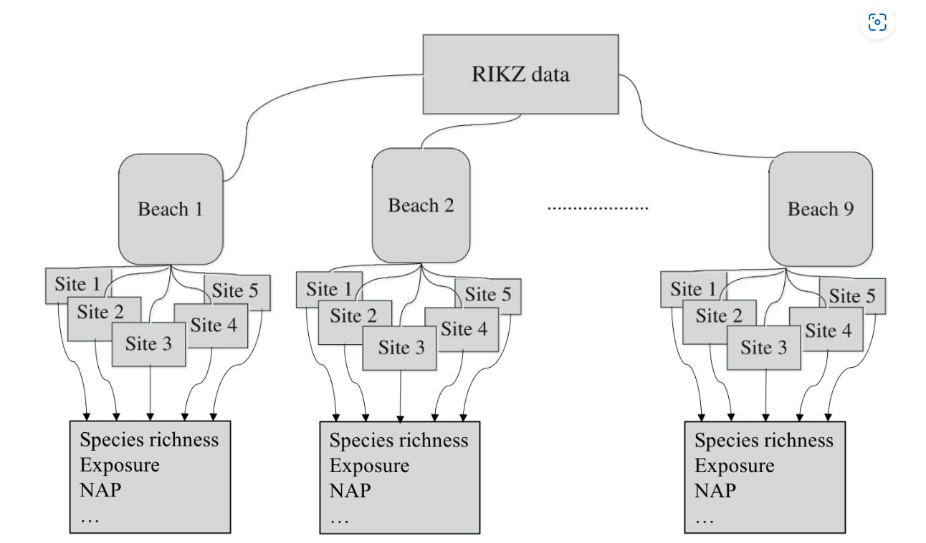
The RIKZ dataset
For each of 9 intertidal areas (denoted ‘Beaches’), the researchers sampled five sites (denoted ‘Sites’) and at each site they measured abiotic variables and the diversity of macro-fauna (e.g. aquatic invertebrates). Here, species richness refers to the total number of species found at a given site while NAP ( i.e. Normal Amsterdams Peil) refers to the height of the sampling location relative to the mean sea level and represents a measure of the amount of food available for birds, etc. For our purpose, the main question is:
What is the influence of NAP on species richness?

Slide 15
Example in R (Standard linear regression)
library(tidyverse)
# Load data
rikz_data <- "https://uoftcoders.github.io/rcourse/data/rikz_data.txt"
download.file(rikz_data, "rikz_data.txt")
rikz_data <- read_delim("rikz_data.txt",
col_names = TRUE,
delim = "\t")
rikz_data <- rikz_data %>%
mutate(Beach = as.factor(Beach))
# Examine structure of the dataframe and view first 5 columns
str(rikz_data)
# Run basic linear model using all of the data.
basic.lm <- lm(Richness~ NAP, data = rikz_data)
summary(basic.lm)

Slide 16
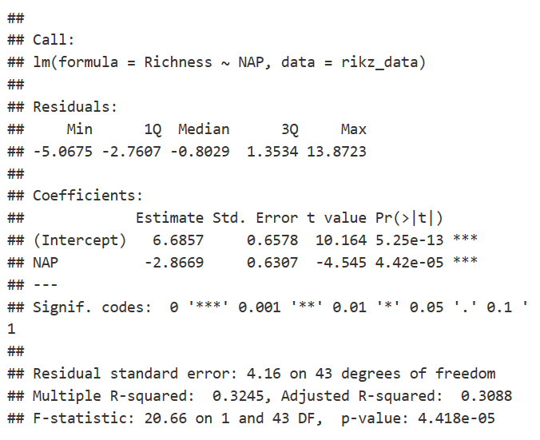
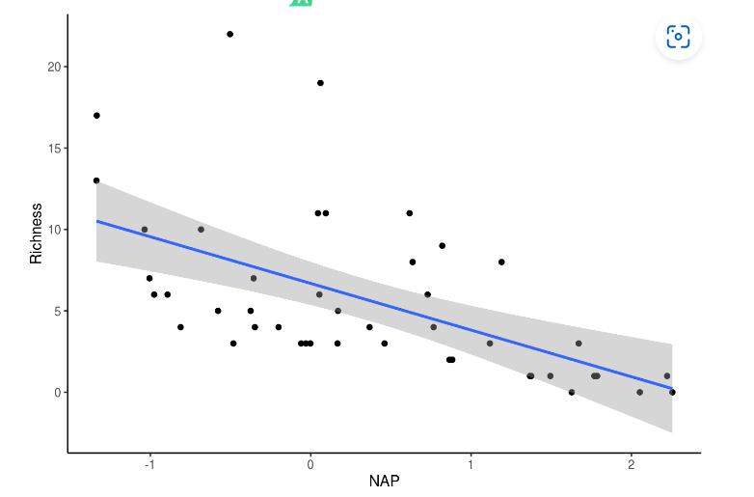
RESULT
From the model output above, it looks like NAP is significantly, negatively (Estimate < 0) associated with species richness. Let’s plot this relationship to see what it looks like.
# Plot relationship from above model ggplot(rikz_data, aes(x = NAP, y = Richness)) +geom_point() +geom_smooth(method = "lm") + theme_classic()
However, before we trust this result, we should confirm that the assumptions of the linear regression are met. We can plot the residuals against the fitted values (homogeneity and independence) and a QQ-plot (normality). Thankfully, R’s base plotting function does all of this work for us.

Slide 17
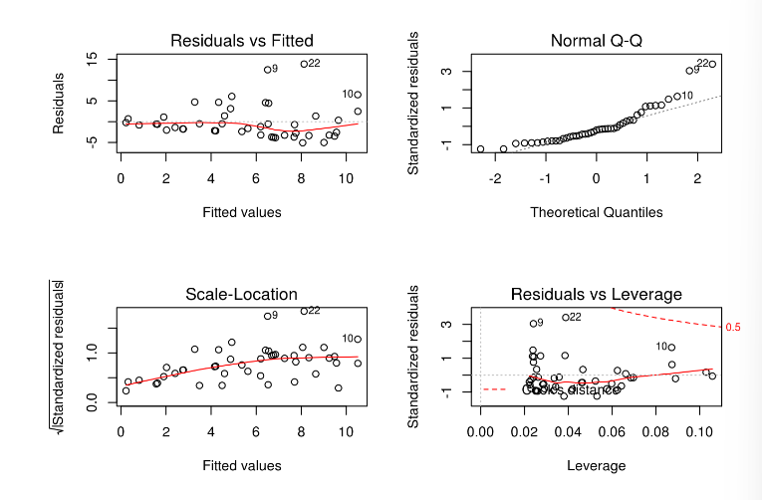
# Check assumptions.
# Normality homogeneity of variance violated
par(mfrow=c(2,2))
plot(basic.lm)
The first and third panels suggest that the homogeneity assumption is violated (increasing variance in the residuals with increasing fitted values). Similarly, panel 2 suggests non-normality (points falling off of the dotted line). A third-root transformation of the response variable (i.e. Richness) seems to alleviate both of these problems.
Tip: Right skewed response variables can be normalized using root transformations (e.g. square root, log, third-root, etc.), with greater roots required for increasingly right-skewed data. Left skewed response variables can be normalized with power transformations (e.g. squared, 3rd power, etc.)
Nonetheless, for the analyses in this section, we will ignore violations of these assumptions for the purpose of better illustrating mixed-effects modelling strategies on untransformed data. In fact, these data violate another, potentially more problematic assumption; namely, the observations are not independent.

Slide 18
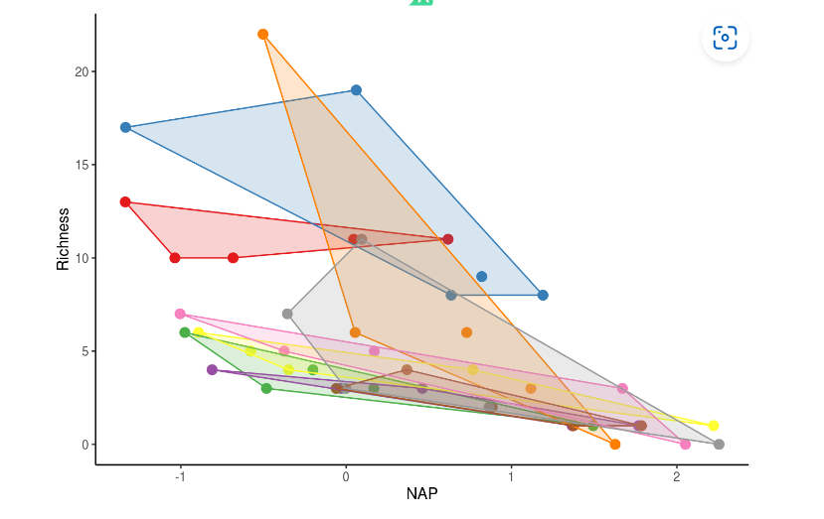
Non-independence of observations
each beach may be independent, sites within a beach are likely to have similar species richness due simply to their proximity within the same beach.
In other words, observations among sites within a beach are not independent
Another way of saying this is that the data are nested.
Other types of nested data include: sampling the same individual pre- and post-treatment or sampling them multiple times (i.e. repeated measures), or sampling multiple tissues from the same individuals.
library(plyr)
# Function to find polygons
find_hull <- function(df) df[chull(df$Richness, df$NAP), ]
# Identify polygons in data
hulls <- ddply(rikz_data, "Beach", find_hull)
# Plot
ggplot(rikz_data, aes(x = NAP, y = Richness, colour = Beach)) +
geom_point(size = 3) +
theme_classic() +
theme(legend.position = "none") +
scale_colour_brewer(palette="Set1") +
scale_fill_brewer(palette="Set1") +
geom_polygon(data=hulls, aes(fill = Beach), alpha = 0.2)
observations from the same beach tend to cluster together.
We need to account for this non-independence in our modelling
Notes:
Remember, the species richness data come from multiple sites within multiple beaches. While each beach may be independent, sites within a beach are likely to have similar species richness due simply to their proximity within the same beach. In other words, observations among sites within a beach are not independent. Another way of saying this is that the data are nested. Nesting in this sense is a product of the experimental design (i.e. we chose to sample 5 sites within each beach) and not necessarily of the data itself. Other types of nested data include: sampling the same individual pre- and post-treatment or sampling them multiple times (i.e. repeated measures), or sampling multiple tissues from the same individuals. We can visualize the non-independence of observation within the same beach by producing a figure similar to the one above but clustered by beach (each beach is a different colour).

Slide 19
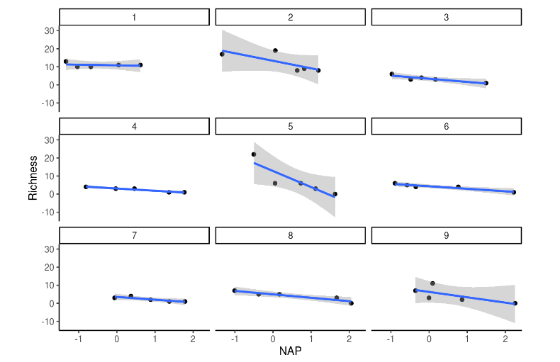
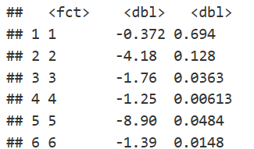
Accounting for non-independence
One approach to account for this non-independence would be to run a separate analysis for each beach, as shown in the figure and table below.
# We could account for non-independence by running a separate analysis
# for each beach
ggplot(rikz_data, aes(x = NAP, y = Richness)) +
geom_point() +
geom_smooth(method = "lm") +
facet_wrap(~ Beach) +
xlab("NAP") + ylab("Richness") +
theme_classic()
# Run linear model of Richness against NAP for each beach
beach_models <- rikz_data %>%
group_by(Beach) %>%
do(mod = lm(Richness ~ NAP, data = .))
# Get the coefficients by group in a tidy data_frame
library(broom)
dfBeachModels = tidy(beach_models, mod)
dfBeachModels %>%
filter(term == "NAP") %>%
dplyr::select(estimate, p.value)
the issue with this approach is that each analysis only has 5 points (a really low sample size!) and we have to run multiple tests. As such, we run the risk of obtaining spuriously significant results purely by chance.

Slide 20
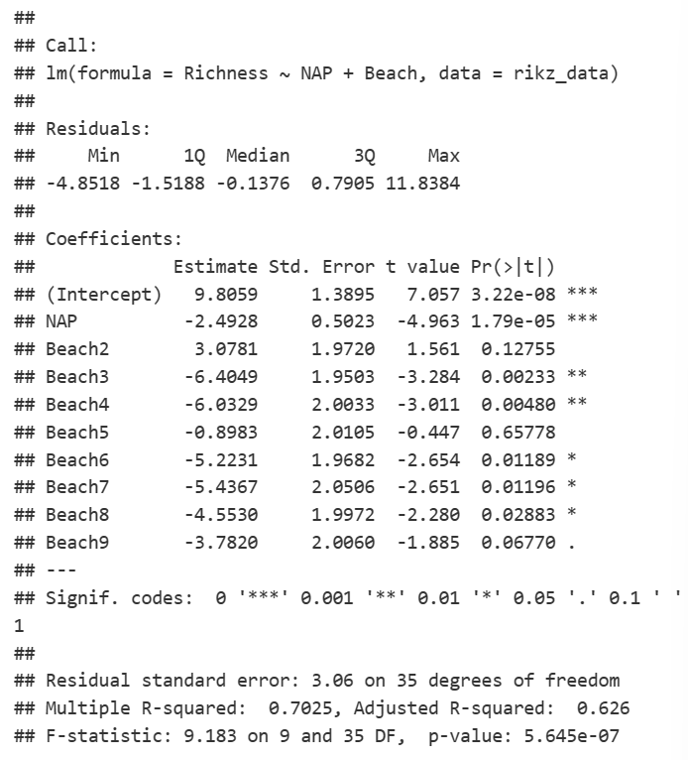
we can simply include a term for beach in our model, thereby estimating its effects
basic.lm <- lm(Richness ~ NAP + Beach, data = rikz_data)
summary(basic.lm)
The model is estimating a separate effect for each level of beach (8 total since 1 is used as the reference)
Notes:
That’s a lot of terms! Note what’s happening here. The model is estimating a separate effect for each level of beach (8 total since 1 is used as the reference). Because we need one degree of freedom to estimate each of these, that’s a total of 8 degrees of freedom! In this case, it had little effect of changing our interpretation of the effects of NAP on richness (which is still negative and significant). However, sometimes the inclusion of additional terms in this way will change the estimated effect of other terms in the model and alter their interpretation. The question we need to ask ourselves here is: Do we really care about differences between beaches? Maybe but probably not. These beaches were a random subset of all beaches that could have been chosen but we still need to account for the non-independence of observations within beaches. This is where random-effects become useful.
Random-effect models

Slide 21
The Linear Mixed Model
The linear mixed model is an extension of the general linear model, in which factors and covariates are assumed to have a linear relationship to the dependent variable.
Factors. Categorical predictors should be selected as factors in the model. Each level of a factor can have a different linear effect on the value of the dependent variable.
Fixed-effects factors are generally thought of as variables whose values of interest are all represented in the data file.
Random-effects factors are variables whose values in the data file can be considered a random sample from a larger population of values. They are useful for explaining excess variability in the dependent variable.
For example, a grocery store chain is interested in the effects of five different types of coupons on customer spending. At several store locations, these coupons are handed out to customers who frequent that location; one coupon selected at random is distributed to each customer.

Slide 22
Random effect
There are many types of random effects, such as
repeated measures of the same individuals; where the scores at each time of measure constitute samples from the same participants among a virtually infinite (and possibly random) number of times of measure from those participants.
Another example of a random effect can be seen in nested designs, where for example; achievement scores of students are nested within classes and those classes are nested within schools. That would be an example of a hierarchical design structure with a random effect for scores nested within classes and a second random effect for classes nested within schools. The nested data structure assumes a relationship among groups such that members of a class are thought to be similar to others in their class in such a way as to distinguish them from members of other classes and members of a school are thought to be similar to others in their school in such a way as to distinguish them from members of other schools. The example used below deals with a similar design which focuses on multiple fixed effects and a single nested random effect.

Slide 23
Example
A fast food chain plans to add a new item to its menu. However, they are still undecided between three possible campaigns for promoting the new product. In order to determine which promotion has the greatest effect on sales, the new item is introduced at locations in several randomly selected markets. A different promotion is used at each location, and the first month sales of the new item recorded.

Slide 24
GLM
Multiple responses from the same subject cannot be regarded as independent from each other.
testmarket_1month.sav in spss
Politeness data in R

Slide 25
Using Linear Mixed Models to Analyze Repeated Measurements
A physician is evaluating a new diet for her patients with a family history of heart disease. To test the effectiveness of this diet, 16 patients are placed on the diet for 6 months. Their weights and triglyceride levels are measured before and after the study, and the physician wants to know if the weights have changed.
This example uses the file dietstudy.sav. See the topic Sample Files for more information. Use Linear Mixed Models to determine whether the diet has an effect on the weights of these patients.
Because the data file was originally set up for analysis in the GLM Repeated Measures procedure, you need to restructure the file from variables to cases.

Slide 26
Using Linear Mixed Models to Analyze a Crossover Trial
A grocery store chain is interested in determining the effects of three different coupons (versus no coupon) on customer spending. To this end, they construct a crossover trial in which a random sample of their regular customers is followed for four weeks. Since they are concerned about carryover effects, the sequence of coupons sent to each customer is carefully considered, and the following table is used:

Slide 27
What is Offset?
Offset is a variable which used in Poisson Regression Analysis. This analysis is used whenever the data is recorded over an observed period. Eg: Number of Customers who arrive at a restaurant in one hour, Number of trees in a square unit area. Here the data is measured under a pre determined period (exposure) rather than absolute numbers (count). Thus Poisson regression is used when the data is rate based (count divided by exposure).
Offset is the variable that is used to denote the exposure period in the Poisson regression. Let us consider the simple linear regression equation given below:
Notes:
Offset - Meaning & Definition | Statistics Overview | MBA Skool

Slide 28
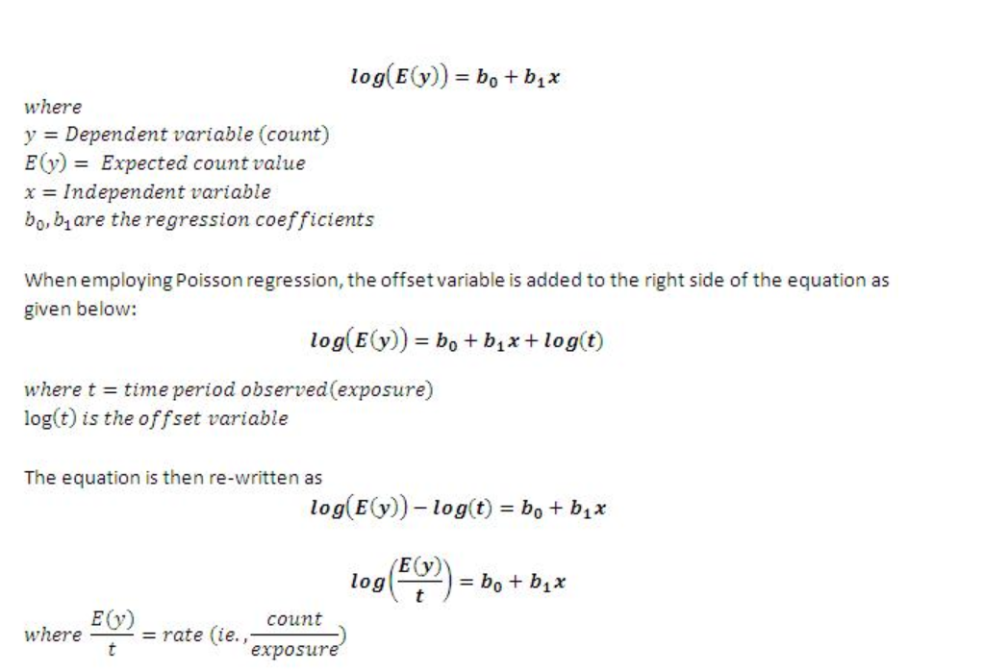
To put it in simple terms, offset variable is the log of the time period under study and has a regression coefficient of 1

Slide 29
Generalized linear models(GLMs)

Slide 30
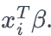
Generalized linear models(GLMs)
The term "generalized" linear model (GLIM or GLM) refers to a larger class of models popularized by McCullagh and Nelder (1982, 2nd edition 1989). In these models, the response variable yi is assumed to follow an exponential family distribution with mean , which is assumed to be some (often nonlinear) function of .Some would call these “nonlinear” because is often a nonlinear function of the covariates, but McCullagh and Nelder consider them to be linear because the covariates affect the distribution of yi only through the linear combination
The first widely used software package for fitting these models was called GLIM. Because of this program, "GLIM" became a well-accepted abbreviation for generalized linear models, as opposed to "GLM" which often is used for general linear models
Notes:
Offset. The offset term is a "structural" predictor. Its coefficient is not estimated by the model but is assumed to have the value 1; thus, the values of the offset are simply added to the linear predictor of the target. This is especially useful in Poisson regression models, where each case may have different levels of exposure to the event of interest.
For example, when modeling accident rates for individual drivers, there is an important difference between a driver who has been at fault in one accident in three years of experience and a driver who has been at fault in one accident in 25 years! The number of accidents can be modeled as a Poisson or negative binomial response with a log link if the natural log of the experience of the driver is included as an offset term.

Slide 31
So far we have always assumed the following normal distribution:
Yi ∼ N (Xiβ, Vi).
For non-normal, e.g.
• binary
• count
• non-normal continuous
responses, the models we discussed so far are not suitable.
The response can be scale, counts, binary, or events-in-trials. Factors are assumed to be categorical. The covariates, scale weight, and offset are assumed to be scale.

Slide 32
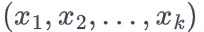
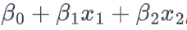
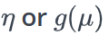
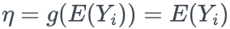
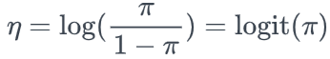
components to any GLM
Random Component - specifies the probability distribution of the response variable; e.g., normal distribution for Y in the classical regression model, or binomial distribution for Y in the binary logistic regression model. This is the only random component in the model; there is not a separate error term.
Systematic Component - specifies the explanatory variables in the model, more specifically, their linear combination; e.g., , as we have seen in a linear regression, and as we will see in the logistic regression in this lesson.
Link Function, - specifies the link between the random and the systematic components. It indicates how the expected value of the response relates to the linear combination of explanatory variables; e.g., for classical regression, or for logistic regression.

Slide 33
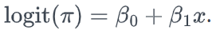
Assumptions
The data Y1,Y2,…, Yn are independently distributed, i.e., cases are independent.
The dependent variable Yi does NOT need to be normally distributed, but it typically assumes a distribution from an exponential family (e.g. binomial, Poisson, multinomial, normal, etc.).
A GLM does NOT assume a linear relationship between the response variable and the explanatory variables, but it does assume a linear relationship between the transformed expected response in terms of the link function and the explanatory variables; e.g., for binary logistic regression
Explanatory variables can be nonlinear transformations of some original variables.
The homogeneity of variance does NOT need to be satisfied. In fact, it is not even possible in many cases given the model structure.
Errors need to be independent but NOT normally distributed.
Parameter estimation uses maximum likelihood estimation (MLE) rather than ordinary least squares (OLS).

Slide 34
Default statistical family to use to fit the model is gaussian but other options include binomial, Gamma, and poisson among others.
The following are three popular examples of GLMs
simple Linear Regression
Binary Logistic Regression
Poisson Regression

Slide 35
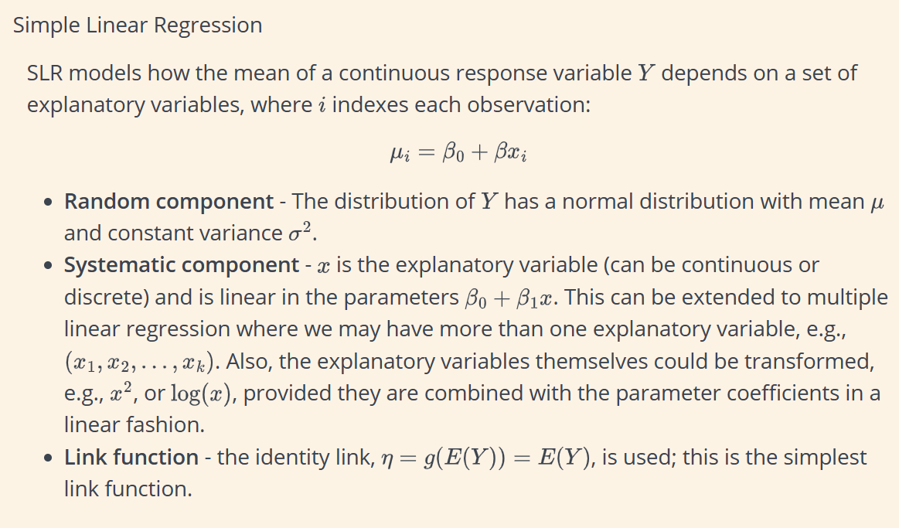

Slide 36
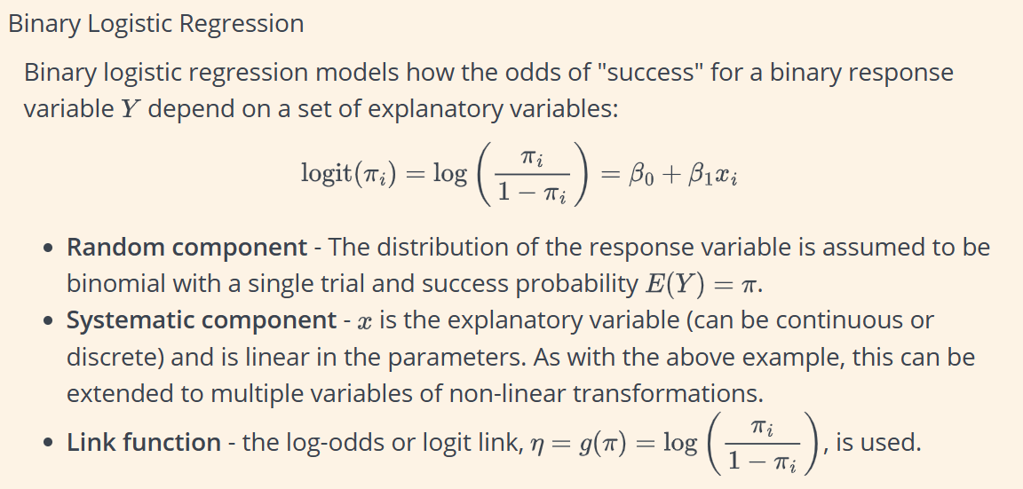

Slide 37
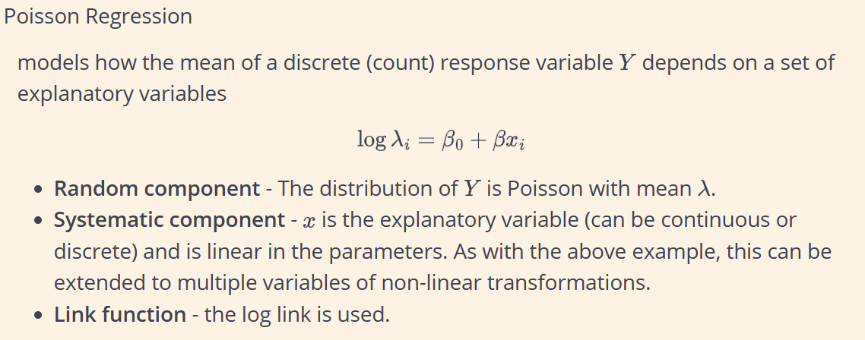

Slide 38
General conception
General use glm fits generalized linear models of y with covariates x:
g{E(y)}= xβ, y ∼ F
g( ) is called the link function, and F is the distributional family. Substituting various definitions for g( ) and F results in a surprising array of models. For instance, if y is distributed as Gaussian (normal) and g( ) is the identity function, we have
E(y) = xβ, y ∼ Normal
or linear regression. If g( ) is the logit function and y is distributed as Bernoulli, we have
logit{E(y)} = xβ, y ∼ Bernoulli
or logistic regression. If g( ) is the natural log function and y is distributed as Poisson, we have
ln{E(y)} = xβ, y ∼ Poisson
or Poisson regression, also known as the log-linear model. Other combinations are possible.

Slide 39
Summary of advantages of GLMs over traditional (OLS) regression
We do not need to transform the response to have a normal distribution.
The choice of link is separate from the choice of random component, giving us more flexibility in modeling.
The models are fitted via maximum likelihood estimation, so likelihood functions and parameter estimates benefit from asymptotic normal and chi-square distributions.
All the inference tools and model checking that we will discuss for logistic and Poisson regression models apply for other GLMs too; e.g., Wald and Likelihood ratio tests, deviance, residuals, confidence intervals, and overdispersion.
There is often one procedure in a software package to capture all the models listed above, e.g. PROC GENMOD in SAS or glm() in R, etc., with options to vary the three components
Notes:
6: Binary Logistic Regression | STAT 504 (psu.edu)

Slide 40
Examples in medicine or
Count data
Binary data
number of side effects after treatment
number of living piglets in a litter
number of episodes in multiple sclerosis patients
Presence (yes/no) of respiratory infection in children
Pain relief (yes/no) after analgesic treatment
Correct solution (yes/no) to a task or test question

Slide 41
Example in Marketing
A shipping company can use generalized linear models to fit a Poisson regression to damage counts for several types of ships constructed in different time periods, and the resulting model can help determine which ship types are most prone to damage.

Slide 42
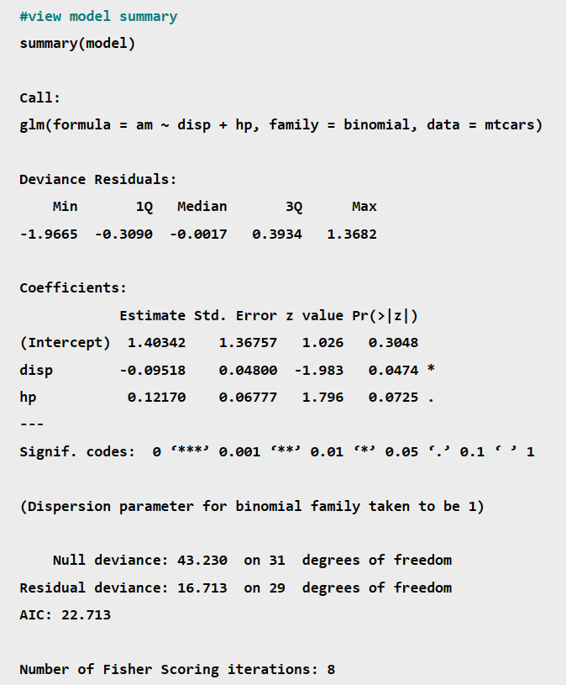
Example with R
we’ll use the built-in mtcars dataset in R:

Slide 43
Coefficients & P-Values
The coefficient estimate in the output indicate the average change in the log odds of the response variable associated with a one unit increase in each predictor variable.For example, a one unit increase in the predictor variable disp is associated with an average change of -0.09518 in the log odds of the response variable am taking on a value of 1. This means that higher values of disp are associated with a lower likelihood of the am variable taking on a value of 1.
The standard error gives us an idea of the variability associated with the coefficient estimate. We then divide the coefficient estimate by the standard error to obtain a z value.For example, the z value for the predictor variable disp is calculated as -.09518 / .048 = -1.983.
The p-value Pr(>|z|) tells us the probability associated with a particular z value. This essentially tells us how well each predictor variable is able to predict the value of the response variable in the model.For example, the p-value associated with the z value for the disp variable is .0474. Since this value is less than .05, we would say that disp is a statistically significant predictor variable in the model.
Depending on your preferences, you may decide to use a significance level of .01, .05, or 0.10 to determine whether or not each predictor variable is statistically significant.

Slide 44
Null & Residual Deviance
The null deviance in the output tells us how well the response variable can be predicted by a model with only an intercept term.
The residual deviance tells us how well the response variable can be predicted by the specific model that we fit with p predictor variables. The lower the value, the better the model is able to predict the value of the response variable.To determine if a model is “useful” we can compute the Chi-Square statistic as:
X² = Null deviance – Residual deviance
with p degrees of freedom.We can then find the p-value associated with this Chi-Square statistic. The lower the p-value, the better the model is able to fit the dataset compared to a model with just an intercept term.
For example, in our regression model we can observe the following values in the output for the null and residual deviance:
Null deviance: 43.23 with df = 31
Residual deviance: 16.713 with df = 29
We can use these values to calculate the X² statistic of the model:
X² = Null deviance – Residual deviance
X² = 43.23 – 16.713
X² = 26.517
There are p = 2 predictor variables degrees of freedom.
We can use the Chi-Square to P-Value Calculator to find that a X² value of 26.517 with 2 degrees of freedom has a p-value of 0.000002.
Since this p-value is much less than .05, we would conclude that the model is highly useful.

Slide 45
AIC
The Akaike information criterion (AIC) is a metric that is used to compare the fit of different regression models. The lower the value, the better the regression model is able to fit the data.It is calculated as:
AIC = 2K – 2ln(L)
where:
K: The number of model parameters.
ln(L): The log-likelihood of the model. This tells us how likely the model is, given the data.
The actual value for the AIC is meaningless.However, if you fit several regression models, you can compare the AIC value of each model. The model with the lowest AIC offers the best fit.

Slide 46
Example with STATA
CODES
Model of y as a function of x when y is a proportion
glm y x, family(binomial)
Logit model of y events occurring in 15 trials as a function of x
glm y x, family(binomial 15) link(logit)
Probit model of y events as a function of x using grouped data with group sizes n
glm y x, family(binomial n) link(probit)
Model of discrete y with user-defined family myfamily and link mylink
glm y x, family(myfamily) link(mylink)
Bootstrap standard errors in a model of y as a function of x with a gamma family and log link
glm y x, family(gamma) link(log) vce(bootstrap)
Menu
Statistics > Generalized linear models > Generalized linear models (GLM)
glm fits generalized linear models. It can fit models by using either IRLS (maximum likelihood) or Newton–Raphson (maximum likelihood) optimization, which is the default
Notes:
rglm.pdf (stata.com)

Slide 47
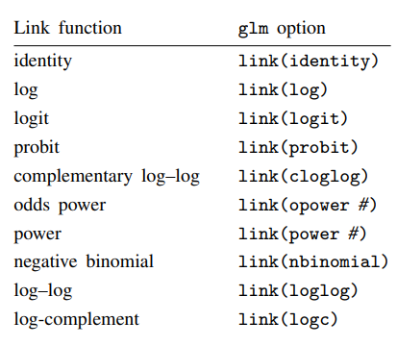
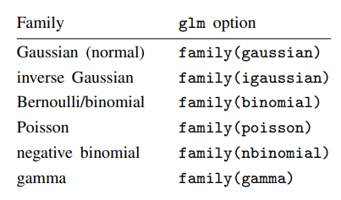
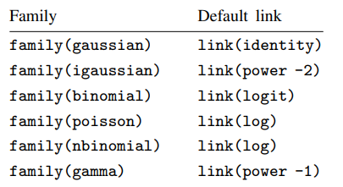
In any case, you specify the link function by using the link() option and specify the distributional family by using family().

Slide 48
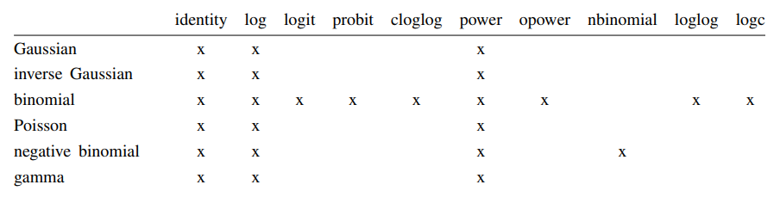
If you specify both family() and link(), not all combinations make sense. You may choose from the following combinations:

Slide 49
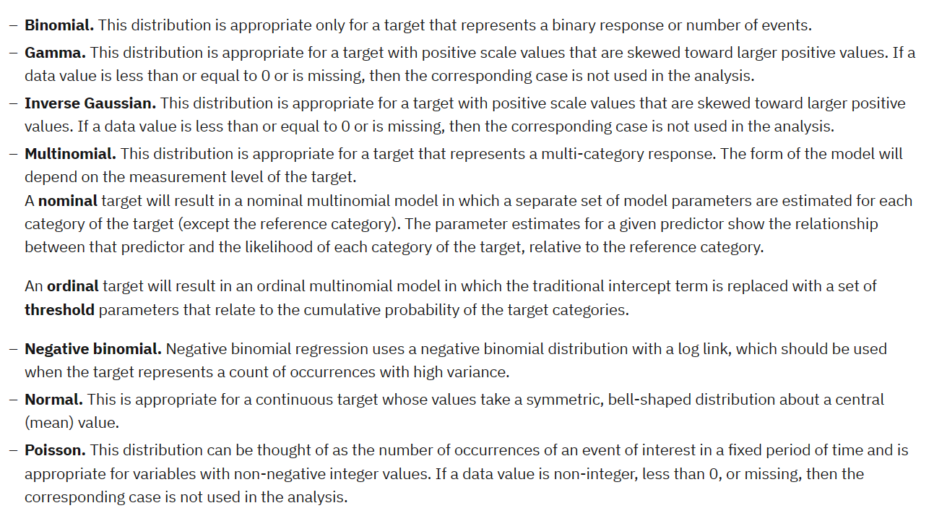
distributions

Slide 50
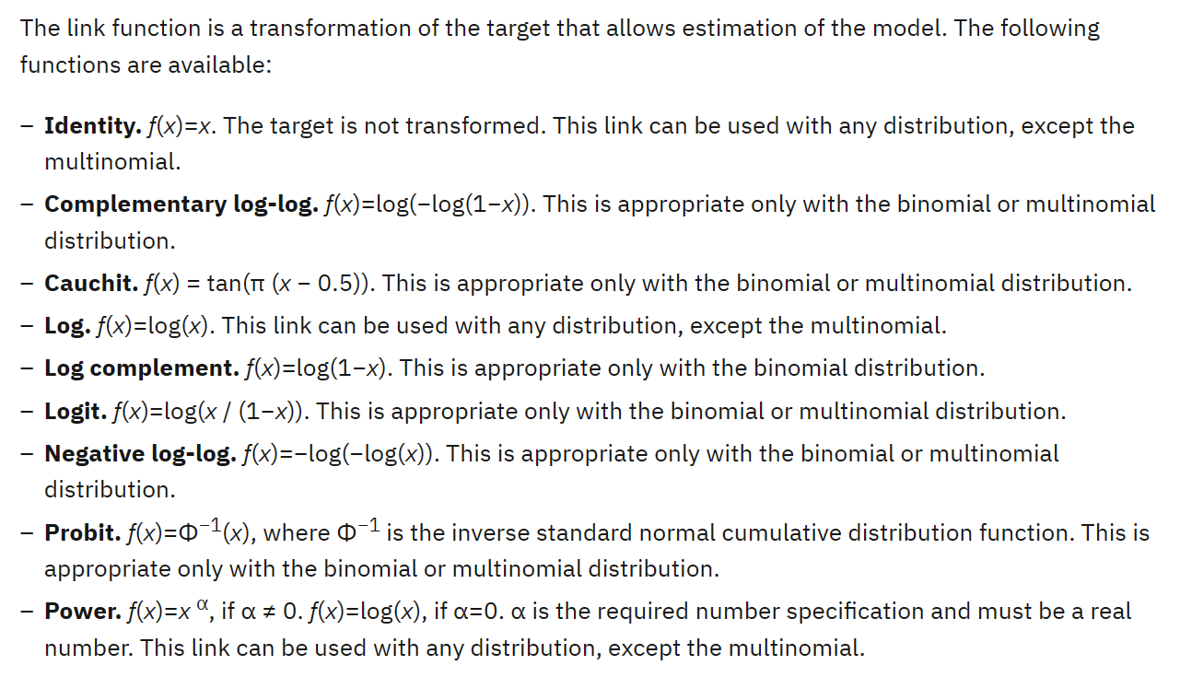
Link function

Slide 51
Longitudinal data
Longitudinal data is used to measure how long events last and can be used to determine the factors that most affect a phenomenon1. Examples of longitudinal studies include2:Up Series
Minnesota Twin Study
Grant Study
Terman Life Cycle Study
National Food Survey

Slide 52
Generalized linear mixed models(GLMMs)

Slide 53
Generalized linear mixed models extend the linear model so that:
The target is linearly related to the factors and covariates via a specified link function.
The target can have a non-normal distribution.
The observations can be correlated.
Generalized linear mixed models cover a wide variety of models, from simple linear regression to complex multilevel models for non-normal longitudinal data.
Notes:
complex multilevel models ==hierarchical linear models, linear mixed-effect model, mixed models, nested data models, random coefficient, random-effects models, random parameter models, or split-plot designs

Slide 54
Generalized linear mixed models (GLMMs) are a natural outgrowth of both linear mixed models and generalized linear models.
generalized linear models (GLMs)
linear mixed models (LMMs).
GLMMs can be developed for non-normally distributed responses, will allow nonlinear links between the mean of the response and the predictors, and can model overdispersion and correlation by incorporating random effects. As such, they are of wide utility

Slide 55
EXAMPLE
Medical researchers can use a generalized linear mixed model to determine whether a new anticonvulsant drug can reduce a patient's rate of epileptic seizures. Repeated measurements from the same patient are typically positively correlated so a mixed model with some random effects should be appropriate. The target field, the number of seizures, takes positive integer values, so a generalized linear mixed model with a Poisson distribution and log link may be appropriate.
Executives at a cable provider of television, phone, and internet services can use a generalized linear mixed model to know more about potential customers. Since possible answers have nominal measurement levels, the company analyst uses a generalized logit mixed model with a random intercept to capture correlation between answers to the service usage questions across service types (tv, phone, internet) within a given survey responder's answers.

Slide 56
Example in SPSS
The district school board wants to know if an experimental teaching method is effective at improving math scores. They select at random schools within the district, then some classrooms within each school. The classrooms are randomly assigned to the experimental or control group, and the classroom teachers are asked to use the new or standard method to teach mathematics in the coming school year. All students within the classrooms are tested at the beginning and end of the school year. The data have a hierarchical 3-level structure: school – class – student with 23 schools, 97 classes and 2209 students.
This information is collected in test_scores.sav
The target, Yijk, is the test score after a teaching method is applied for a year at school i, class j and student k. The possible predictors come from different levels.

Slide 57
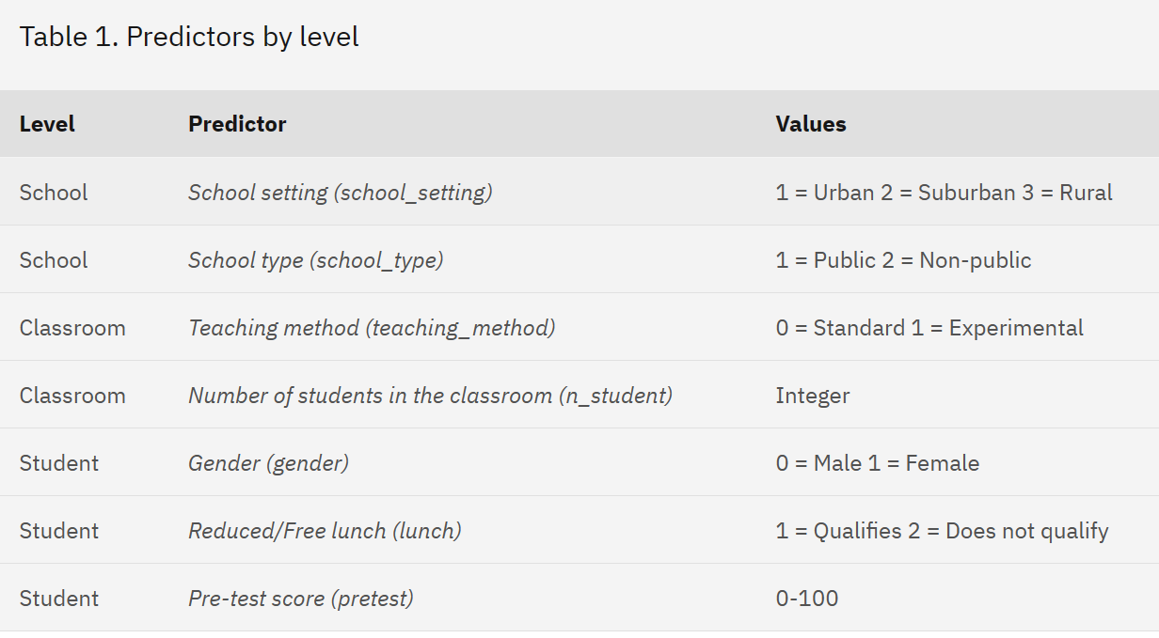

Slide 58
Select School (school), Classroom (classroom), and Student ID (student_id) as subject fields
On the Target settings, confirm that Post-test (posttest) is selected as the target. Post-test (posttest) has a predefined role as a target, so it is automatically selected as the target by default.
Confirm that Linear model is selected in the Target Distribution and Relationship (Link) with the Linear Model group. The linear model assumes a normal distribution for the target and uses an identity link function.
in Fixed Effects Confirm that Use custom inputs is selected.
Select School setting, School type, Teaching method, Number of students in the classroom, Gender, Reduced/Free lunch, and Pre-test, and drag to the Main drop zone to create the main effects.The fields with categorical (flag, nominal, or ordinal) measurement level are treated as factors by the procedure and those with continuous (scale) measurement level are treated as covariates.
In Random Effects, Confirm that two intercept-only random effect subject blocks exist; one with school as the subject field and one with school*classroom as the subject field. The procedure automatically creates a Random Effect block for each subject beyond the innermost subject.The first block should account for correlation between classrooms within the same school. The second block should account for correlation between students within the same classroom.
Click run

Slide 59
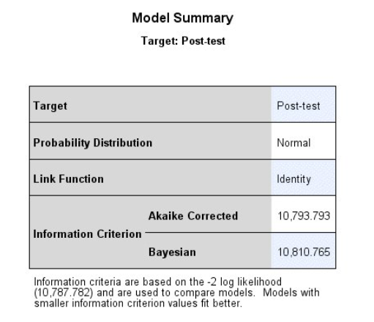
Result:Model Summary
By default, the procedure creates a model object in the output Viewer. Alternatively, you can generate pivot tables and charts by selecting Pivot tables and charts in the Output Display group on the Output tab of the Options dialog (Edit > Options).
This example uses the model object. Activate the object by double-clicking on it.
The first visible model view is a high-level summary of the model and its fit. Confirm basic model selections like the choices of target, probability distribution, and link function. Three fit values are listed:
Akaike Corrected. The Akaike information criterion, corrected (AICC) is a measure for selecting and comparing models based on the -2 log likelihood. Smaller values indicate better models. The AICC "corrects" the Akaike information criterion (AIC) for small sample sizes. As the sample size increases, the AICC converges to the AIC. The AIC "penalizes" overparametrized models.
Bayesian. The Bayesian information criterion (BIC) is a measure for selecting and comparing models based on the -2 log likelihood. Smaller values indicate better models. The BIC also penalizes overparametrized models, but more strictly than the AIC because the BIC accounts for the size of the dataset as well as the size of the model.
-2 log likelihood. Listed in a footnote under the table, the -2 log likelihood is the basis for the AIC and BIC.

Slide 60
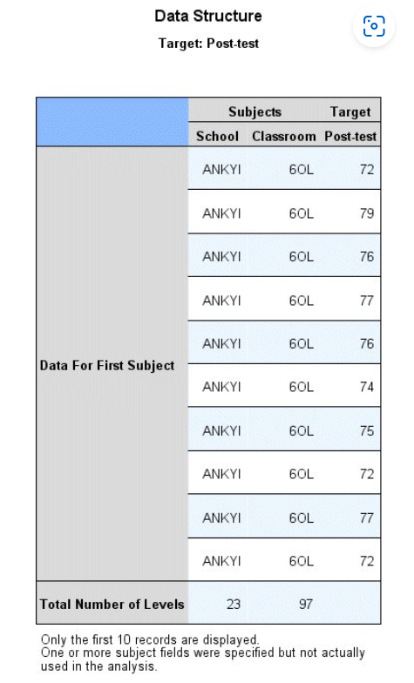
Result: Data Structure
This view helps you to confirm your data structure selections, and shows the actual values for the first subject. Note that though you specified Student ID on the data structure tab, it is not displayed in the table because it is not used in the model, either as a subject specification in a random effect block or for repeated measures (there are no repeated measures in the model at all). The purpose of specifying Student ID as a subject in the dialog is largely for the automatic creation of the random effect blocks that use school and school*classroom for subject effects, and because it is natural to think of each student as an individual subject in the study.

Slide 61
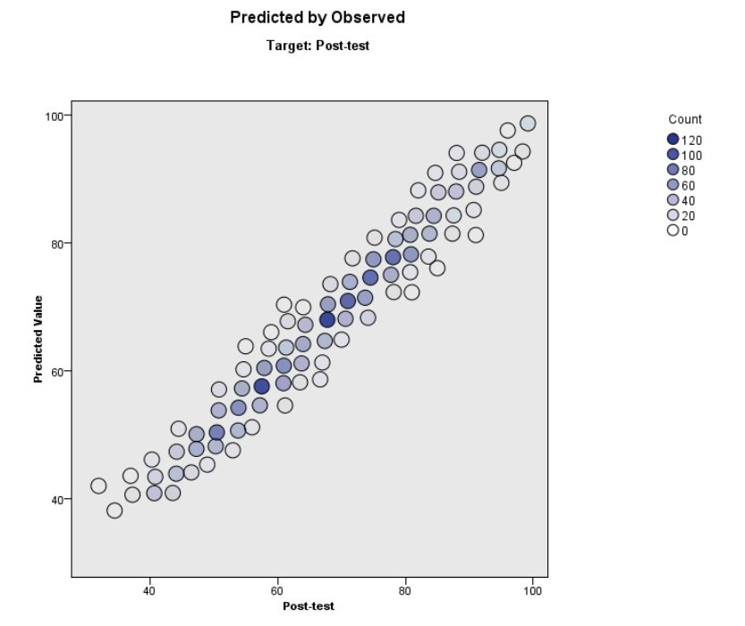
Predicted by Observed
The points lie near the diagonal, which means that no records are fit badly by the model.

Slide 62
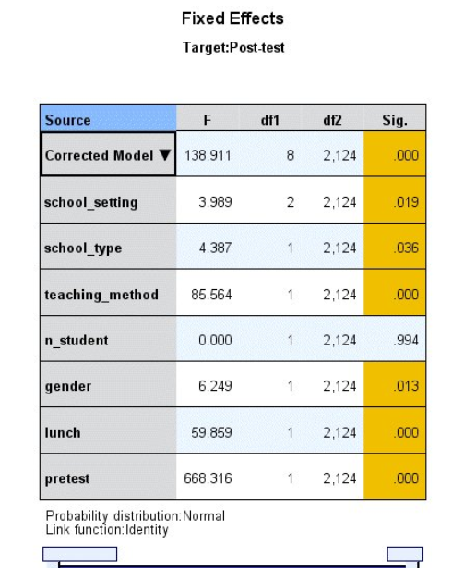
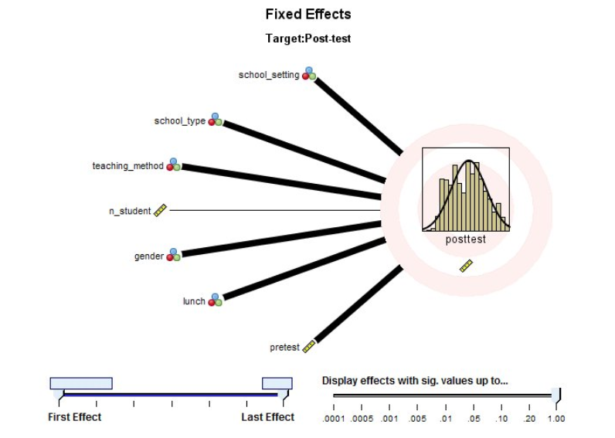
Fixed Effects
This is a visualization of the traditional tests of fixed effects table. The effects are ordered from top to bottom in the order in which they were specified on the Fixed Effects settings, and the thickness of each connecting line is based on the statistical significance of the effect. Note that this view displays field names rather than field labels because, under the assumption that field labels will generally be longer than field names, displaying labels for interactions and nested effects would quickly become unwieldy.
This is the traditional tests of fixed effects table for the overall model and individual effects. The model, and all effects except n_student (Number of students in the classroom), appear to be statistically significant.

Slide 63
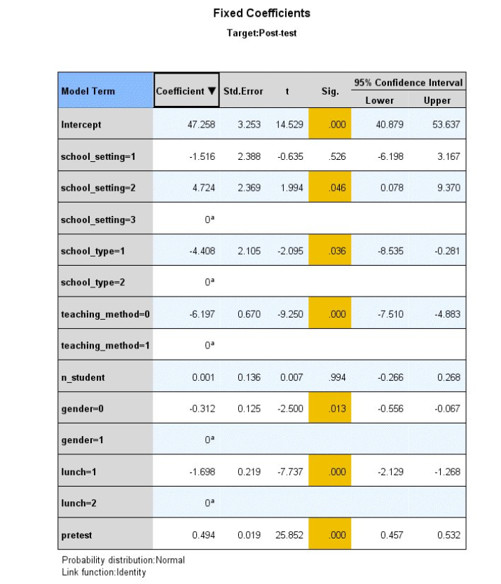
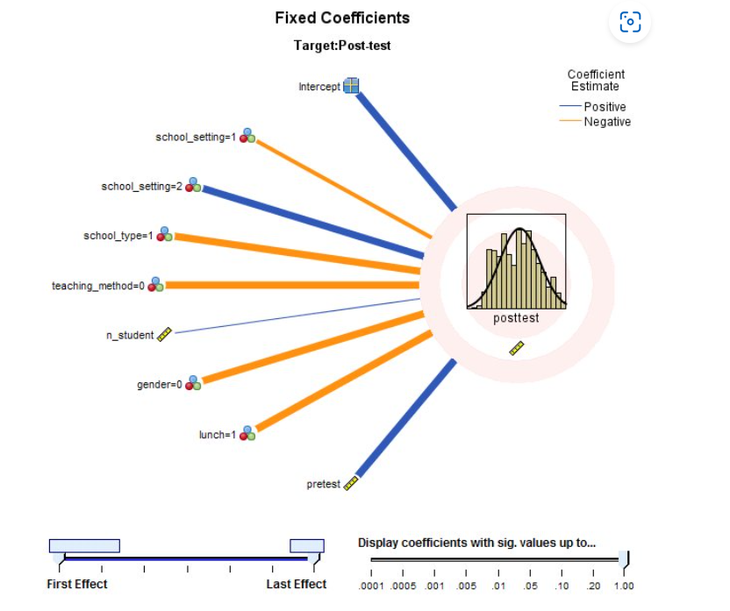
Fixed Coefficients
This is the traditional parameter estimates table for the overall model and individual effects. The coefficients show the relationship of each model parameter to Post-test score. For a continuous field, the coefficient is the expected change in test score for a unit increase in the value of the continuous field. For example, the value of 0.001 for n_student (Number of students in the classroom) means that, all other things being equal, we would expect the test score of a student in a classroom with 16 students to be 0.001 points higher than the score of a student in a classroom with 15 students.
For the categorical fields in this model, the coefficient is the expected change in test score relative to the reference category of the categorical field. The reference category is the last (highest valued) category, marked as redundant (meaning that the parameter is equal to a linear combination of other parameters in the model), and its coefficient value is set to 0. For example, the reference category for school_setting (School setting) is school_setting=3 , and the value of 4.724 for school_setting=2 means that, all other things being equal, we would expect the test score of a student at a suburban school to be 4.724 points higher than a student at a rural school.

Slide 64
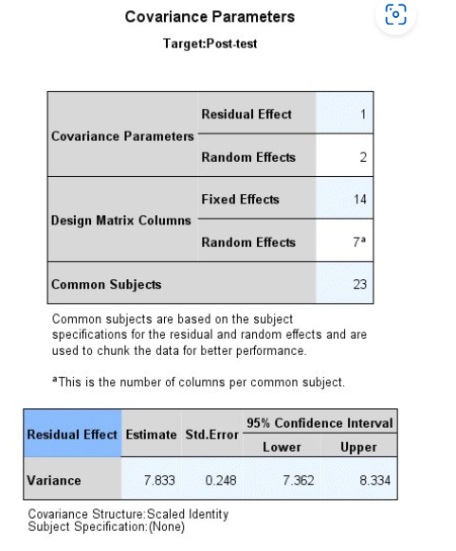
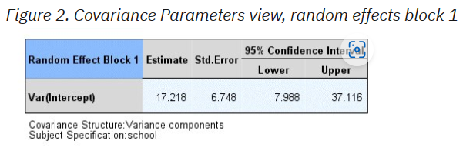
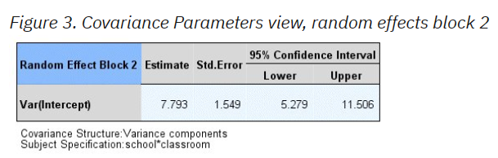
Covariance Parameters
This view displays the covariance parameter estimates and related statistics for residual and random effects. The residual (R) covariance parameters are shown by default. There are no repeated measures, so there is a single variance estimate for the residuals.
This is the variance estimate for the intercept of the random effect with school defining subjects, and is a measure of the between-school variation. The estimate is large relative to the residual variance and (looking ahead) the variance for Block 2, suggesting that most of the variability in test scores that is not explained by the fixed effects can be explained by school-to-school variation, but the standard error is also large, so there is a lot of uncertainty concerning the actual size of this effect.
This is the variance estimate for the intercept of the random effect with school*classroom defining subjects, and is a measure of between-classroom variation. The size of the effect is roughly equivalent to the residual variance, but with a little more uncertainty in the estimate; that is, a larger standard error.

Slide 65

Comparing to a linear regression model
The school board wonders whether the mixed model is better than a relatively simple linear regression model.
To fit a linear regression model, recall the Generalized Linear Mixed Models dialog.
On the Random Effects settings, select the two random effects blocks and delete them.
Click Run.

Slide 66
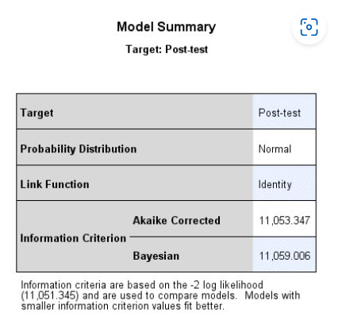
Model Summary
Based on the information criteria, the linear mixed model with two random intercepts is preferred over the linear regression model because it has smaller AICC (10793.793 < 11053.347) and BIC (10811.765 < 11059.006) values.
Based on a likelihood ratio test, the linear mixed model with two random intercepts is still preferred. Under the null hypothesis that the variances for the two random intercepts is zero, the difference in the −2 restricted log likelihoods (−2LL) for the two models has a chi-square distribution with degrees of freedom equal to the difference in the number of model parameters. The linear mixed model has a −2LL of 10787.782 and 12 parameters; the linear regression has a −2LL of 11051.344 and 10 parameters. The p value for the likelihood ratio test is the probability that a chi-square random variate with 12−10 = 2 degrees of freedom is larger than (11051.345 − 10787.782 = 263.563), which is near 0.

Slide 67
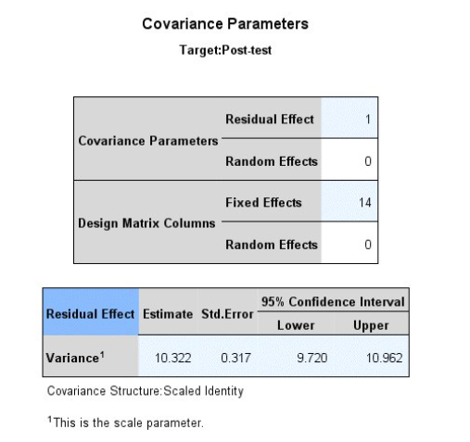
Covariance Parameters
The variance estimate for the residual effect is larger in the linear regression than in the linear mixed model. Given the information criteria and −2LL statistics, we expected the amount of variation left unexplained by the linear regression to be greater than the variation unexplained by the linear mixed model.

Slide 68
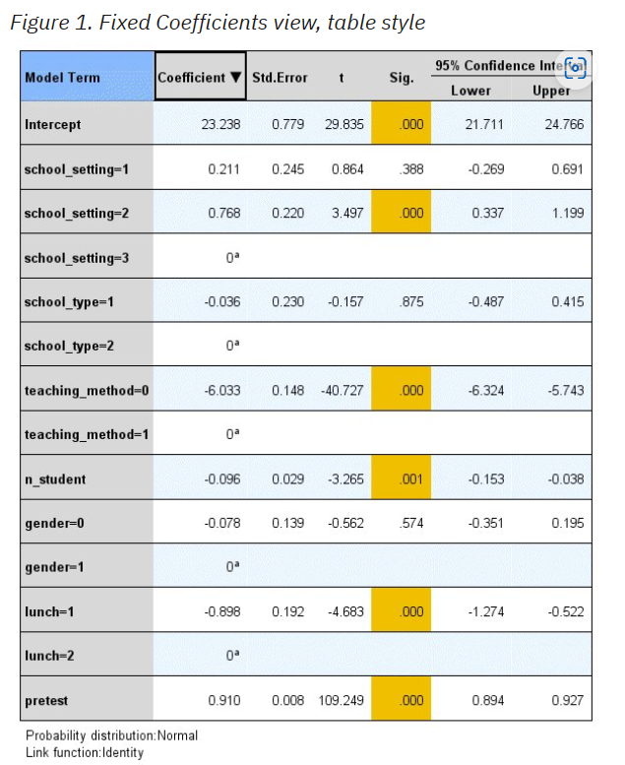
Fixed Coefficients
Compared to the parameter estimates for the linear mixed model, the significant teaching_method=0 effect indicates the experimental teaching method is indeed effective in both models, and we can expect a student taught by the new method to score 6 points higher than a student taught by the standard method, all other things being equal. This might imply that, regardless of the statistical superiority of the linear mixed model, it doesn't affect the school board's final decision to implement the new teaching method. However, there are a few important differences between the two models.
First, the standard error for the effect of the teaching method is too small in the linear regression model, resulting in an overly optimistic 95% confidence interval of [−6.324, −5.743]. The "honest" estimate from the linear mixed model is [−7.510, −4.883] more properly reflects the uncertainty in size of the effect of the experimental teaching method.
Next, the coefficient estimates for all other effects are very different between the two models, so the interpretation of these effects is different. In particular, the effects School type (school_type) and Gender (gender) are statistically significant in the linear mixed model but not the linear regression, and Number of students in classroom (n_student) is significant in the linear regression but not the linear mixed model.
Lastly, the large and significant variance estimates for the two random intercepts (17.219 and 7.793) indicate that heterogeneity among schools and among classes should not be ignored, and make the standard errors of the coefficients larger, especially those corresponding to school-level and class-level predictors, including the teaching method (to come back to the first point).

Slide 69

Generalized Linear Models understanding the link function

Slide 70
Generalized Linear Models understanding the link function | R-bloggers
Generalized Linear Models (‘GLMs’) are one of the most useful modern statistical tools, because they can be applied to many different types of data. Count, binary ‘yes/no’, and waiting time data are just some of the types of data that can be handled with GLMs.
We often call such data ‘non-normal’ because its distribution doesn’t follow a normal distribution (also known as the bell curve or Gaussian Distribution).
In this post I will look at how GLMs use a ‘link function’ to model non-normal data. I think there is a sort of beautiful elegance in the maths of how the link function works. Understanding this theory will also help you build better models for your data and interpret them in more nuanced ways.

Slide 71
The fields with categorical (flag, nominal, or ordinal) measurement level are treated as factors by the procedure and those with continuous (scale) measurement level are treated as covariates.

Slide 72
Repeated Measures
Repeated Measures design is an experimental design where the same participants participate in each independent variable condition. This means that each experiment condition includes the same group of participants.
Repeated Measures design is also known as within-groups or within-subjects design.
Pro: As the same participants are used in each condition, participant variables (i.e., individual differences) are reduced.
Con: There may be order effects. Order effects refer to the order of the conditions affecting the participants’ behavior. Performance in the second condition may be better because the participants know what to do (i.e., practice effect). Or their performance might be worse in the second condition because they are tired (i.e., fatigue effect). This limitation can be controlled using counterbalancing.
Pro: Fewer people are needed as they participate in all conditions (i.e., saves time).
Control: To combat order effects, the researcher counter-balances the order of the conditions for the participants. Alternating the order in which participants perform in different conditions of an experiment.
Counterbalancing
Suppose we used a repeated measures design in which all of the participants first learned words in “loud noise” and then learned them in “no noise.”
We expect the participants to learn better in “no noise” because of order effects, such as practice. However, a researcher can control for order effects using counterbalancing.
The sample would split into two groups experimental (A) and control (B). For example, group 1 does ‘A’ then ‘B,’ and group 2 does ‘B’ then ‘A.’ This is to eliminate order effects.
Although order effects occur for each participant, they balance each other out in the results because they occur equally in both groups.

